Slide 1

Wifi Bastion
by
2211CS040134 – Sailakshman Rangisetti
2211CS040139 – S Mohammed Aadil 2211CS040156 – T. Bhavesh
Under the Guidance of
Mrs G. Sailaja
Assistant Professor
Department of Cyber Security
School of Engineering
Malla Reddy University
Hyderabad, Telangana, INDIA

Slide 2
ABSTRACT
Wi-Fi Bastion is a cutting-edge web-based application developed to safeguard users from potential cyber threats posed by malicious Wi-Fi networks. By scanning available Wi-Fi networks in real time, the app detects and identifies suspicious networks, such as those with weak or no encryption, or networks attempting to mimic legitimate hotspots through "Evil Twin" attacks. The application employs Python for backend processing, utilizing advanced network scanning libraries to analyze SSIDs, BSSIDs, encryption types, and signal strengths. The intuitive front-end interface, built with HTML, CSS, and JavaScript using Bootstrap, ensures a modern, responsive design, providing a seamless user experience across various devices. Real-time results and alerts are displayed interactively, empowering users to make informed decisions before connecting to any Wi-Fi network. To enhance user security, Wi-Fi Bastion integrates a MongoDB database for storing historical network scan data and patterns, allowing users to track potential threats over time. The application provides detailed insights into each detected network, including the risk level associated with each, and sends instant notifications for any identified security risks.

Slide 3
1. Introduction
1.1 Problem Definition
With the increasing use of public Wi-Fi networks in places like airports, cafes, and hotels, users are becoming increasingly vulnerable to cyber threats such as weak encryption, unsecured networks, and "Evil Twin" attacks where malicious actors mimic legitimate Wi-Fi hotspots. These threats can lead to severe consequences, including data breaches, identity theft, and unauthorized access to personal information. Despite the availability of security tools, many users lack the technical expertise or resources to detect and avoid these risks in real-time. This gap highlights the need for an accessible and efficient solution to safeguard users against malicious Wi-Fi networks.
1.2 Problem Description
Wi-Fi Bastion addresses the challenge of identifying and mitigating the risks posed by malicious Wi-Fi networks by offering a web-based application that scans and analyzes available networks in real time. The application leverages advanced technologies to detect weak encryption, impersonation attacks, and other vulnerabilities, providing users with actionable insights through an intuitive, responsive interface. By integrating a robust backend with MongoDB for historical data storage and Python-powered algorithms for network analysis, Wi-Fi Bastion empowers users to make informed decisions while connecting to Wi-Fi networks, ensuring privacy and security across various environments.

Slide 4
1.2 Objectives of the Project
Aim of the project:
The aim of the Wi-Fi Bastion project is to develop a web-based application that enhances user security by detecting and identifying malicious Wi-Fi networks in real time. The application seeks to protect individuals and businesses from potential cyber threats, such as weak encryption, unsecured networks, and "Evil Twin" attacks, by providing actionable insights, real-time alerts, and historical data analysis. Through a user-friendly interface and advanced backend processing, the project aims to ensure safe and informed connectivity in public and private spaces, empowering users to navigate Wi-Fi networks confidently without compromising their privacy or security.

Slide 5
1.3 Scope of the project
Determining Goals:
The primary goal of the Wi-Fi Bastion project is to provide a reliable and efficient solution for detecting malicious Wi-Fi networks, safeguarding users against cyber threats like weak encryption, unsecured networks, and impersonation attacks. The application aims to empower users with real-time insights, allowing them to make informed decisions when connecting to public or private networks. Additionally, the project seeks to create a scalable, cross-platform solution accessible from any modern web browser, ensuring global usability and adaptability to evolving cybersecurity challenges.
Data Constraints:
The application processes sensitive data, including network details such as SSIDs, BSSIDs, encryption types, and signal strengths, within strict data privacy guidelines. To protect user data, the app avoids storing personally identifiable information (PII) and ensures encrypted communication between the frontend and backend. MongoDB is used for storing historical scan data securely, with constraints on database indexing and query optimization to maintain performance while managing large datasets..

Slide 6
1.3 Scope of the project
Workflow Management Strategies:
The project adopts an agile workflow management approach, dividing development into iterative phases for backend, frontend, and database integration. Clear milestones, such as implementing real-time scanning, threat detection algorithms, and user authentication, ensure timely progress. Collaborative tools like Git for version control and task management platforms like Trello or Jira are utilized to coordinate efforts, track progress, and address potential issues efficiently. Regular testing and user feedback cycles further ensure the delivery of a robust and user-centric application.

Slide 7
2. System Analysis
Existing System:
2.1 Background & Literature Survey
The increasing reliance on public Wi-Fi networks has introduced significant security risks, including data breaches and cyberattacks. Research indicates that attackers exploit unsecured networks or set up malicious hotspots to steal sensitive data. Common attacks include "Evil Twin" scenarios where fake networks mimic legitimate ones, and network sniffing, where attackers intercept unencrypted traffic. Existing studies highlight the need for real-time network analysis tools to identify and mitigate these risks. While some commercial solutions offer basic security alerts, most are either expensive, overly complex, or lack the capability to analyze and store historical data. Wi-Fi Bastion builds upon the research and best practices outlined in cybersecurity studies to offer a comprehensive, user-friendly solution combining real-time scanning, pattern recognition, and accessible reporting.

Slide 8
2.2 Limitations of Existing System:
Lack of Accessibility: Many existing systems are designed for technical experts, leaving average users without a practical solution to detect malicious networks.
Limited Real-Time Analysis: Current tools often fail to provide real-time scanning, relying instead on pre-set schedules that may not catch immediate threats.
Insufficient Data Storage: Historical data on network scans is rarely stored, preventing users from identifying patterns or recurring threats over time.
High Costs: Comprehensive network security solutions are often subscription-based and too expensive for individual users or small businesses.
Limited Cross-Platform Support: Some systems are tied to specific platforms, reducing accessibility for users with diverse devices or operating systems.

Slide 9
2.3 Proposed System:
Real-Time Threat Detection: The system identifies malicious networks instantly, enabling users to make informed decisions before connecting.
User-Friendly Interface: A modern, intuitive design built with HTML, CSS, JavaScript, and Bootstrap ensures ease of use for all users.
Comprehensive Risk Assessment: The system evaluates networks based on multiple parameters like encryption type, signal strength, and SSID behavior to provide detailed insights.
Data Security and Privacy: By avoiding storage of personally identifiable information (PII) and using encryption for communications, the system ensures user privacy.
Scalability: The use of MongoDB and Python makes the system adaptable to growing datasets and user bases.Cross-Platform Compatibility: The application can be accessed through any modern web browser, ensuring accessibility across devices and operating systems.

Slide 10
2.4 Software Requirements
Backend:
Language: Python 3.9 or later
Frameworks: Flask or Django for web application development
Libraries: Scapy, Pyshark (for network scanning), Flask-SocketIO (for real-time updates)
Database: MongoDB (local or cloud-based using MongoDB Compass)
Other Tools: Jinja2 (for templating), Python AsyncIO (for non-blocking operations)
Frontend:
Languages: HTML5, CSS3, JavaScript
Frameworks: Bootstrap 5, AJAX (for dynamic content updates), Chart.js (for data visualization)
Deployment:
IDE: PyCharm, Visual Studio Code, or Sublime Text
Version Control: Git and GitHub
Web Server: : Gunicorn or WSGI for deployment
Browser Support: Compatible with modern browsers like Chrome, Firefox, Edge
Operating System: Windows 10 or later, macOS, or Linux (Ubuntu 20.04 or higher)

Slide 11
2.5 Hardware Requirements
Server Requirements (Hosting Environment):
Processor: Minimum dual-core 2.0 GHz CPU
RAM: 4 GB (8 GB recommended for optimal performance)
Storage: Minimum 50 GB of disk space for database and logs
Network: High-speed internet connection for real-time operations
Client Requirements (User Devices):
Processor: Minimum dual-core 1.6 GHz CPU
RAM: 2 GB or higher
Storage: 1 GB free space (for temporary application files)
Network: Stable internet connection

Slide 12
Feasibility Analysis:
Technical Feasibility:
Wi-Fi Bastion leverages proven technologies and tools that ensure its technical feasibility. The backend employs Python, known for its extensive libraries like Scapy and Pyshark, which simplify network scanning and analysis. MongoDB is chosen for its flexibility in handling dynamic data structures and scalability. The frontend technologies (HTML, CSS, JavaScript, Bootstrap) provide a responsive and modern user experience. With Python's integration capabilities, real-time communication using Flask-SocketIO is achievable. Additionally, the application's compatibility with cross-platform browsers ensures widespread accessibility, making the technical implementation both feasible and effective.
Robustness and Scalability:
Wi-Fi Bastion is designed to handle real-time network scans with high efficiency and accuracy. Its architecture allows for easy scaling, using asynchronous programming (e.g., Python's asyncio) and database indexing to maintain performance under increased user loads. The robust backend ensures that the system remains stable during intensive operations, while MongoDB's scalability enables seamless storage of growing historical data. The application’s modular design allows for future enhancements, ensuring long-term usability and adaptability to evolving cybersecurity challenges.

Slide 13
Feasibility Analysis:
Economic Feasibility:
Wi-Fi Bastion is economically viable due to its cost-effective development and deployment. By using open-source technologies like Python, Flask, MongoDB, and Bootstrap, the project minimizes software licensing costs. The hardware requirements for hosting and client usage are modest, making it affordable for both developers and end users. Furthermore, the project can offer freemium pricing models, providing basic features for free while charging for advanced functionalities. This approach ensures accessibility for individuals and businesses while maintaining profitability for the application’s growth and maintenance.

Slide 14
3. Architectural Design
3.1 Module Design
1. Network Scanning Module:
Function: Scans available Wi-Fi networks and retrieves key details like SSID, BSSID, encryption type, signal strength, and network quality.
Technologies: Python libraries such as scapy or wifi for network scanning and data collection.
2. Threat Detection Module:
Function: Analyzes the networks based on predefined rules to detect weak encryption (e.g., WEP), unsecured networks, and Evil Twin attacks.
Technologies: Heuristic algorithms and pattern recognition methods to identify networks mimicking legitimate hotspots.
3. Database Module:
Function: Stores scan results, user-specific data, and historical scan records in MongoDB, allowing users to view past scans and track patterns over time.
Technologies: MongoDB Compass for local database management, with cloud synchronization for global accessibility.

Slide 15
3.1 Module Design
4. Frontend Module:
Function: Displays real-time network scan results, risk levels, and notifications. Offers a user-friendly interface for interacting with the app.
Technologies: HTML, CSS, JavaScript, and Bootstrap for responsive and modern web design.
5. Notification and Alerts Module:
Function: Sends notifications when a suspicious network is detected, alerting the user about potential risks.
Technologies: JavaScript and web APIs for push notifications or real-time updates.
6. User Authentication and Profile Management Module:
Function: Manages user authentication (login and signup) and stores user-specific data such as preferred settings, scan history, and alert preferences.
Technologies: Flask or Django for backend authentication, with JWT (JSON Web Tokens) or session-based login for secure access. MongoDB is used to store user profiles and settings.

Slide 16
3.2 Method & Algorithm Design
1. Scanning & Data Collection:
Utilize PyWiFi to scan available Wi-Fi networks.
Gather SSID, BSSID, signal strength, encryption type, and other parameters.
Store scan results in MongoDB for historical analysis.
2. Threat Detection Algorithm:
Evil Twin Detection: Compare SSIDs and BSSIDs to identify duplicate networks.
Weak Encryption Detection: Flag networks using WEP or open authentication.
Rogue AP Detection: Detect unauthorized access points using network fingerprints.
3. User Alert & Response Mechanism:
Notify users via GUI or CLI upon detecting threats.
Provide mitigation steps like disconnecting from suspicious networks.

Slide 17
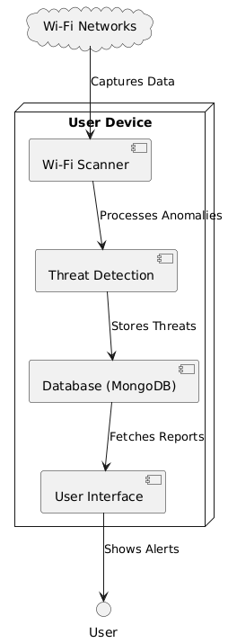
3.3 Project Architecture:
3.3.1 Architecture Diagram:

Slide 18
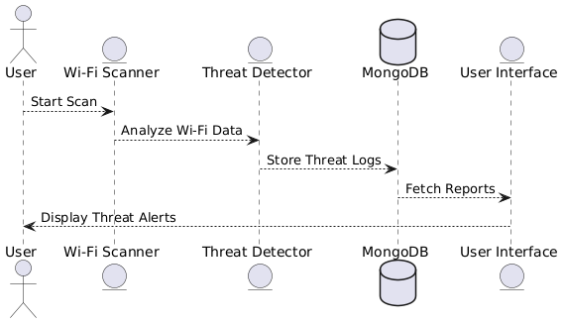
3.3.2 Data Flow Diagram:

Slide 19
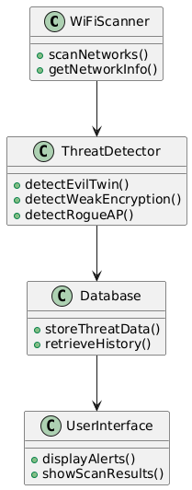
3.3.3 Class Diagram:

Slide 20
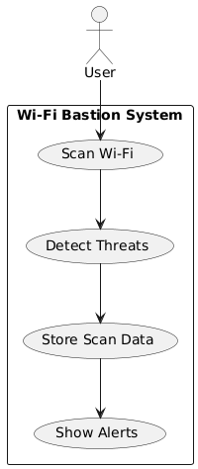
3.3.4 Use Case Diagram:

Slide 21
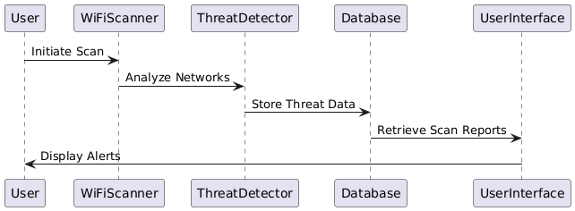
3.3.5 Sequence Diagram:

Slide 22
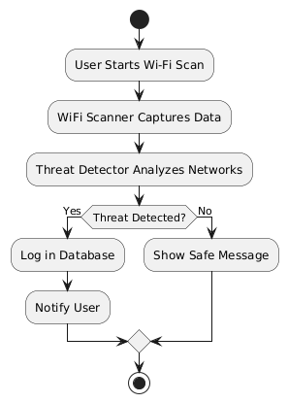
3.3.6 Activity Diagram:

Slide 23
4. Implementation & Testing
4.1 Coding Blocks:
# Configuration settings for Wi-Fi Bastion
# MongoDB Configuration
MONGO_URI = "mongodb://localhost:27017/"
MONGO_DB = "wifi_bastion"
MONGO_COLLECTION = "wifi_scans"
# Application Settings
DEBUG_MODE = True
SCAN_WAIT_TIME = 3 # seconds to wait for scan completion
# Threat Detection Settings
WEAK_ENCRYPTION_TYPES = ["Open (No Encryption)", "WPA"]
SIGNAL_ANOMALY_THRESHOLD = 30 # dBm difference to consider suspicious
# AKM Mapping for Encryption Types
AKM_MAPPING = {
0: "Open (No Encryption)",
1: "WPA",
2: "WPA2",
3: "WPA3",
4: "WPA2-PSK",
5: "WPA3-PSK"
}

Slide 24
from pymongo import MongoClient
from config import MONGO_URI, MONGO_DB, MONGO_COLLECTION
import logging
import time
# Configure logging
logging.basicConfig(level=logging.INFO, format='%(asctime)s - %(name)s - %(levelname)s - %(message)s')
logger = logging.getLogger(__name__)
class DatabaseManager:
"""Handles all database operations for the Wi-Fi Bastion application."""
def __init__(self):
"""Initialize database connection using configuration settings."""
try:
self.client = MongoClient(MONGO_URI)
self.db = self.client[MONGO_DB]
self.collection = self.db[MONGO_COLLECTION]
logger.info(f"Connected to MongoDB database: {MONGO_DB}")
except Exception as e:
logger.error(f"Failed to connect to MongoDB: {str(e)}")
raise
def insert_networks(self, networks):
"""Insert new networks into the database.
Args:
networks (list): List of network dictionaries to insert

Slide 25
Returns:
tuple: (success, result_or_error) where success is a boolean and
result_or_error is either the inserted IDs or an error message
"""
try:
if not networks:
return True, []
result = self.collection.insert_many(networks)
logger.info(f"Inserted {len(result.inserted_ids)} networks into database")
return True, result.inserted_ids
except Exception as e:
logger.error(f"Error inserting networks into database: {str(e)}")
return False, str(e)
def find_existing_networks(self, ssids):
"""Find existing networks in the database by their SSIDs.
Args:
ssids (list): List of SSIDs to search for
Returns:
dict: Dictionary mapping SSIDs to their database documents
"""
try:
if not ssids:
return {}

Slide 26
existing_networks = self.collection.find({"ssid": {"$in": ssids}})
return {doc['ssid']: doc for doc in existing_networks}
except Exception as e:
logger.error(f"Error finding existing networks: {str(e)}")
return {}
def get_all_scans(self):
"""Retrieve all network scans from the database.
Returns:
tuple: (success, result_or_error) where success is a boolean and
result_or_error is either the scan results or an error message
"""
try:
scans = list(self.collection.find())
return True, scans
except Exception as e:
logger.error(f"Error fetching scan history: {str(e)}")
return False, str(e)
def block_network(self, network_id, bssid):
"""Add a network to the blocklist.
Args:
network_id (str): The ID of the network to block
bssid (str): The BSSID of the network to block
Returns:
tuple: (success, result_or_error) where success is a boolean and
result_or_error is either the success message or an error message
"""

Slide 27
try:
# Create a blocklist collection if it doesn't exist
if 'blocklist' not in self.db.list_collection_names():
self.db.create_collection('blocklist')
# Check if network is already blocked
if self.db.blocklist.find_one({"bssid": bssid}):
return True, "Network already blocked"
# Add network to blocklist
result = self.db.blocklist.insert_one({
"network_id": network_id,
"bssid": bssid,
"blocked_at": time.time()
})
logger.info(f"Blocked network with BSSID {bssid}")
return True, "Network successfully blocked"
except Exception as e:
logger.error(f"Error blocking network: {str(e)}")
return False, str(e)
def get_blocked_networks(self):
"""Get all blocked networks.
Returns:
tuple: (success, result_or_error) where success is a boolean and
result_or_error is either the list of blocked networks or an error message
"""

Slide 28
try:
if 'blocklist' not in self.db.list_collection_names():
return True, []
blocked = list(self.db.blocklist.find())
# Convert ObjectId to string for each document
for network in blocked:
network["_id"] = str(network["_id"])
return True, blocked
except Exception as e:
logger.error(f"Error getting blocked networks: {str(e)}")
return False, str(e)
def unblock_network(self, network_id):
"""Remove a network from the blocklist.
Args:
network_id (str): The ID of the network to unblock
Returns:
tuple: (success, result_or_error) where success is a boolean and
result_or_error is either the success message or an error message
"""
try:
if 'blocklist' not in self.db.list_collection_names():
return False, "Blocklist collection does not exist"

Slide 29
4.2 Sample Code:
import pywifi
from pywifi import PyWiFi, const, Profile
import time
from collections import defaultdict
import logging
from config import AKM_MAPPING, SCAN_WAIT_TIME, WEAK_ENCRYPTION_TYPES, SIGNAL_ANOMALY_THRESHOLD
# Configure logging
logging.basicConfig(level=logging.INFO, format='%(asctime)s - %(name)s - %(levelname)s - %(message)s')
logger = logging.getLogger(__name__)
class WiFiScanner:
"""Handles Wi-Fi scanning and threat detection operations."""
def __init__(self, db_manager=None):
"""Initialize the Wi-Fi scanner."""
try:
self.wifi = PyWiFi()
self.interface = self.wifi.interfaces()[0] # Use the first available Wi-Fi interface
self.db_manager = db_manager # Store database manager for blocklist access
logger.info(f"Initialized Wi-Fi scanner using interface: {self.interface.name()}")
except Exception as e:
logger.error(f"Failed to initialize Wi-Fi scanner: {str(e)}")
raise
def get_encryption_type(self, network):
"""Determine Wi-Fi encryption type.

Slide 30
Args:
network: PyWiFi network object
Returns:
str: Human-readable encryption type
"""
encryption = "Unknown"
try:
if hasattr(network, 'akm') and network.akm:
akm_value = network.akm[0]
encryption = AKM_MAPPING.get(akm_value, "Unknown encryption")
except Exception as e:
logger.warning(f"Error determining encryption type: {str(e)}")
return encryption
def scan_networks(self):
"""Scan for Wi-Fi networks.
Returns:
list: List of detected networks with their properties
"""
try:
self.interface.scan()
logger.info(f"Initiated Wi-Fi scan, waiting {SCAN_WAIT_TIME} seconds for completion")
time.sleep(SCAN_WAIT_TIME) # Wait for scan completion
results = self.interface.scan_results()
logger.info(f"Scan completed, found {len(results)} networks")

Slide 31
networks = []
for network in results:
ssid = network.ssid.strip()
if not ssid: # Skip networks with empty SSIDs (will be handled later as hidden)
ssid = "" # Ensure empty string for hidden networks
network_info = {
'ssid': ssid,
'bssid': network.bssid,
'signal': f"{network.signal} dBm",
'encryption': self.get_encryption_type(network),
}
networks.append(network_info)
return self.detect_threats(networks)
except Exception as e:
logger.error(f"Error scanning Wi-Fi networks: {str(e)}")
return []
def detect_threats(self, networks):
"""Analyze networks and detect security threats.
Args:
networks (list): List of network dictionaries
Returns:
list: Networks with added threat information
"""

Slide 32
try:
ssid_counts = defaultdict(list) # Store BSSIDs per SSID
bssid_counts = defaultdict(list) # Store SSIDs per BSSID
# First pass: build the lookup dictionaries
for net in networks:
ssid_counts[net["ssid"]].append(net)
bssid_counts[net["bssid"]].append(net)
# Get blocked networks if database manager is available
blocked_networks = []
if self.db_manager:
blocked_networks = self.db_manager.get_blocked_networks()
# Second pass: detect threats for each network
for net in networks:
threats = []
# Check if network is blocked
if net["bssid"] in blocked_networks:
threats.append("🚫 Network Blocked")
# Evil Twin Attack Detection (Multiple BSSIDs for the same SSID)
if len(ssid_counts[net["ssid"]]) > 1:
threats.append("🚨 Evil Twin Attack Detected")
# MAC Spoofing Detection (Multiple SSIDs with same BSSID)
if len(bssid_counts[net["bssid"]]) > 1:
threats.append("🚨 MAC Spoofing Detected")

Slide 33
# Weak Encryption Detection
if net["encryption"] in WEAK_ENCRYPTION_TYPES:
threats.append("⚠️ Weak Encryption")
# Hidden SSID Detection
if net["ssid"] == "":
threats.append("⚠️ Hidden SSID Detected")
# Signal Strength Anomalies (Possible Fake AP)
if len(ssid_counts[net["ssid"]]) > 1:
try:
signal_strengths = [int(n["signal"].split(" ")[0]) for n in ssid_counts[net["ssid"]]]
max_signal, min_signal = max(signal_strengths), min(signal_strengths)
if abs(max_signal - min_signal) > SIGNAL_ANOMALY_THRESHOLD: # If signal variance is large
threats.append("🚨 Signal Anomaly (Possible Fake AP)")
except (ValueError, IndexError) as e:
logger.warning(f"Error analyzing signal strengths: {str(e)}")
net["threats"] = ", ".join(threats) if threats else "✅ No Threats Detected"
logger.info(f"Threat detection completed for {len(networks)} networks")
return networks
except Exception as e:
logger.error(f"Error during threat detection: {str(e)}")
# Return networks without threat analysis rather than failing completely
for net in networks:
net["threats"] = "⚠️ Threat detection failed"
return networks

Slide 34
# app.py from flask import Flask, render_template, jsonify, request
import logging
import datetime
from wifi_scanner import WiFiScanner
from database import DatabaseManager
from config import DEBUG_MODE
# Configure logging
logging.basicConfig(level=logging.INFO, format='%(asctime)s - %(name)s - %(levelname)s - %(message)s')
logger = logging.getLogger(__name__)
app = Flask(__name__)
# Initialize components
db_manager = DatabaseManager()
wifi_scanner = WiFiScanner(db_manager)
# Custom Jinja filter for timestamp conversion
@app.template_filter('timestamp_to_date')
def timestamp_to_date(timestamp):
"""Convert a Unix timestamp to a readable date format."""
if timestamp:
return datetime.datetime.fromtimestamp(timestamp).strftime('%Y-%m-%d %H:%M:%S')
return 'N/A'

Slide 35
# Custom Jinja filter to replace Django's {% now %} tag
@app.template_filter('now')
def now_filter(format_string):
"""Return the current date in the specified format."""
today = datetime.datetime.now()
if format_string == 'F j, Y':
return today.strftime('%B %d, %Y')
return today.strftime(format_string)
@app.route("/")
def home():
return render_template("home.html")
@app.route("/scan", methods=["GET"])
def scan_page():
return render_template("scan.html")
@app.route("/scan", methods=["POST"])
def scan():
"""Perform Wi-Fi scan and detect threats, then store results in MongoDB."""
try:
# Use the WiFiScanner to scan networks
networks = wifi_scanner.scan_networks()
if not networks:
logger.warning("No networks found during scan")
return jsonify({"status": "error", "message": "No networks found."}), 404

Slide 36
# Get existing networks from database
existing_ssids = [net['ssid'] for net in networks]
existing_ssids_in_db = db_manager.find_existing_networks(existing_ssids)
# Identify new networks to insert
new_networks = [net for net in networks if net['ssid'] not in existing_ssids_in_db]
# Insert new networks into database
if new_networks:
success, result = db_manager.insert_networks(new_networks)
if success:
# Add IDs to the new networks
for net, obj_id in zip(new_networks, result):
net["_id"] = str(obj_id) # Convert ObjectId to string
else:
logger.error(f"Database insertion error: {result}")
return jsonify({"status": "error", "message": result}), 500
# Add IDs to existing networks
for net in networks:
if net['ssid'] in existing_ssids_in_db:
net["_id"] = str(existing_ssids_in_db[net['ssid']]['_id'])
return jsonify(networks) # All networks now have string _id fields
except Exception as e:
logger.error(f"Error during scan operation: {str(e)}")
return jsonify({"status": "error", "message": str(e)}), 500

Slide 37
@app.route('/history')
def history():
"""Retrieve Wi-Fi scan history."""
try:
success, result = db_manager.get_all_scans()
if not success:
logger.error(f"Error fetching scan history: {result}")
return jsonify({"status": "error", "message": result}), 500
formatted_scans = [{"_id": str(scan["_id"]), **{k: v for k, v in scan.items() if k != "_id"}} for scan in result]
return render_template('history.html', scans=formatted_scans)
except Exception as e:
logger.error(f"Error in history route: {str(e)}")
return jsonify({"status": "error", "message": str(e)}), 500
@app.route('/block_network', methods=['POST'])
def block_network():
"""Add a network to the blocklist."""
try:
network_id = request.form.get('network_id')
bssid = request.form.get('bssid')
if not network_id or not bssid:
return jsonify({"status": "error", "message": "Missing network ID or BSSID"}), 400
success, message = db_manager.block_network(network_id, bssid)
if not success:
logger.error(f"Error blocking network: {message}")
return jsonify({"status": "error", "message": message}), 500

Slide 38
return jsonify({"status": "success", "message": message})
except Exception as e:
logger.error(f"Error in block_network route: {str(e)}")
return jsonify({"status": "error", "message": str(e)}), 500
@app.route('/unblock_network', methods=['POST'])
def unblock_network():
"""Remove a network from the blocklist."""
try:
network_id = request.form.get('network_id')
if not network_id:
return jsonify({"status": "error", "message": "Missing network ID"}), 400
success, message = db_manager.unblock_network(network_id)
if not success:
logger.error(f"Error unblocking network: {message}")
return jsonify({"status": "error", "message": message}), 500
return jsonify({"status": "success", "message": message})
except Exception as e:
logger.error(f"Error in unblock_network route: {str(e)}")
return jsonify({"status": "error", "message": str(e)}), 500
@app.route('/blocked')
def blocked_networks():
"""Display all blocked networks."""
try:
success, blocked = db_manager.get_blocked_networks()

Slide 39
if not success:
logger.error(f"Error fetching blocked networks: {blocked}")
return jsonify({"status": "error", "message": blocked}), 500
return render_template('blocked.html', networks=blocked)
except Exception as e:
logger.error(f"Error in blocked_networks route: {str(e)}")
return jsonify({"status": "error", "message": str(e)}), 500
@app.route('/privacy')
def privacy():
"""Display privacy policy."""
return render_template('privacy.html')
@app.route('/terms')
def terms():
"""Display terms of service."""
return render_template('terms.html')
if __name__ == "__main__":
app.run(debug=DEBUG_MODE)

Slide 40
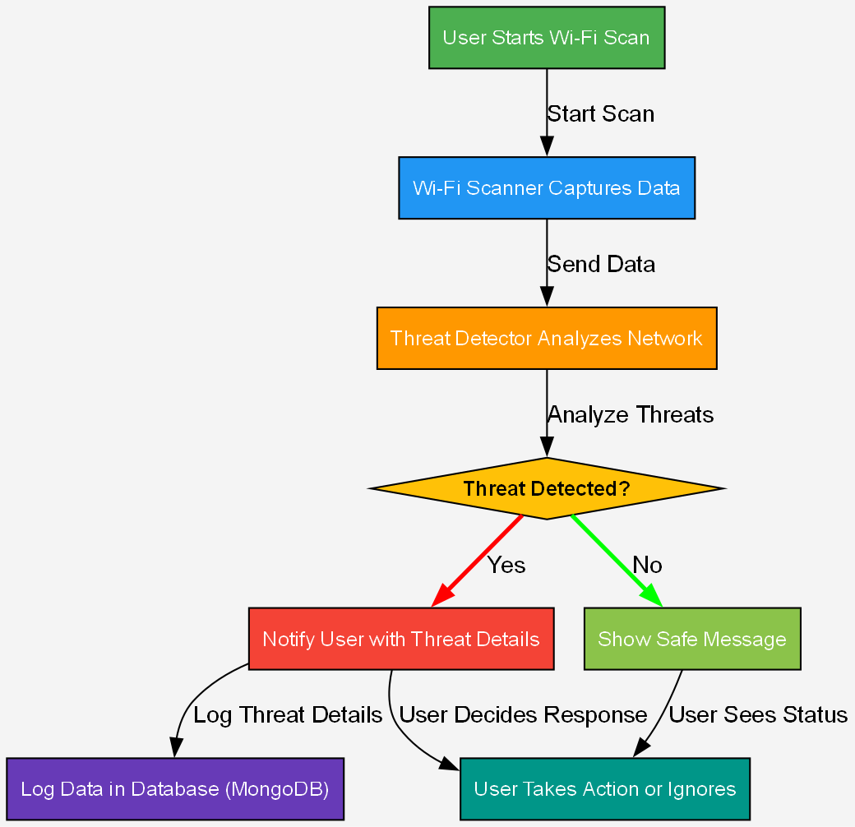
4.3 Execution Flow:

Slide 41
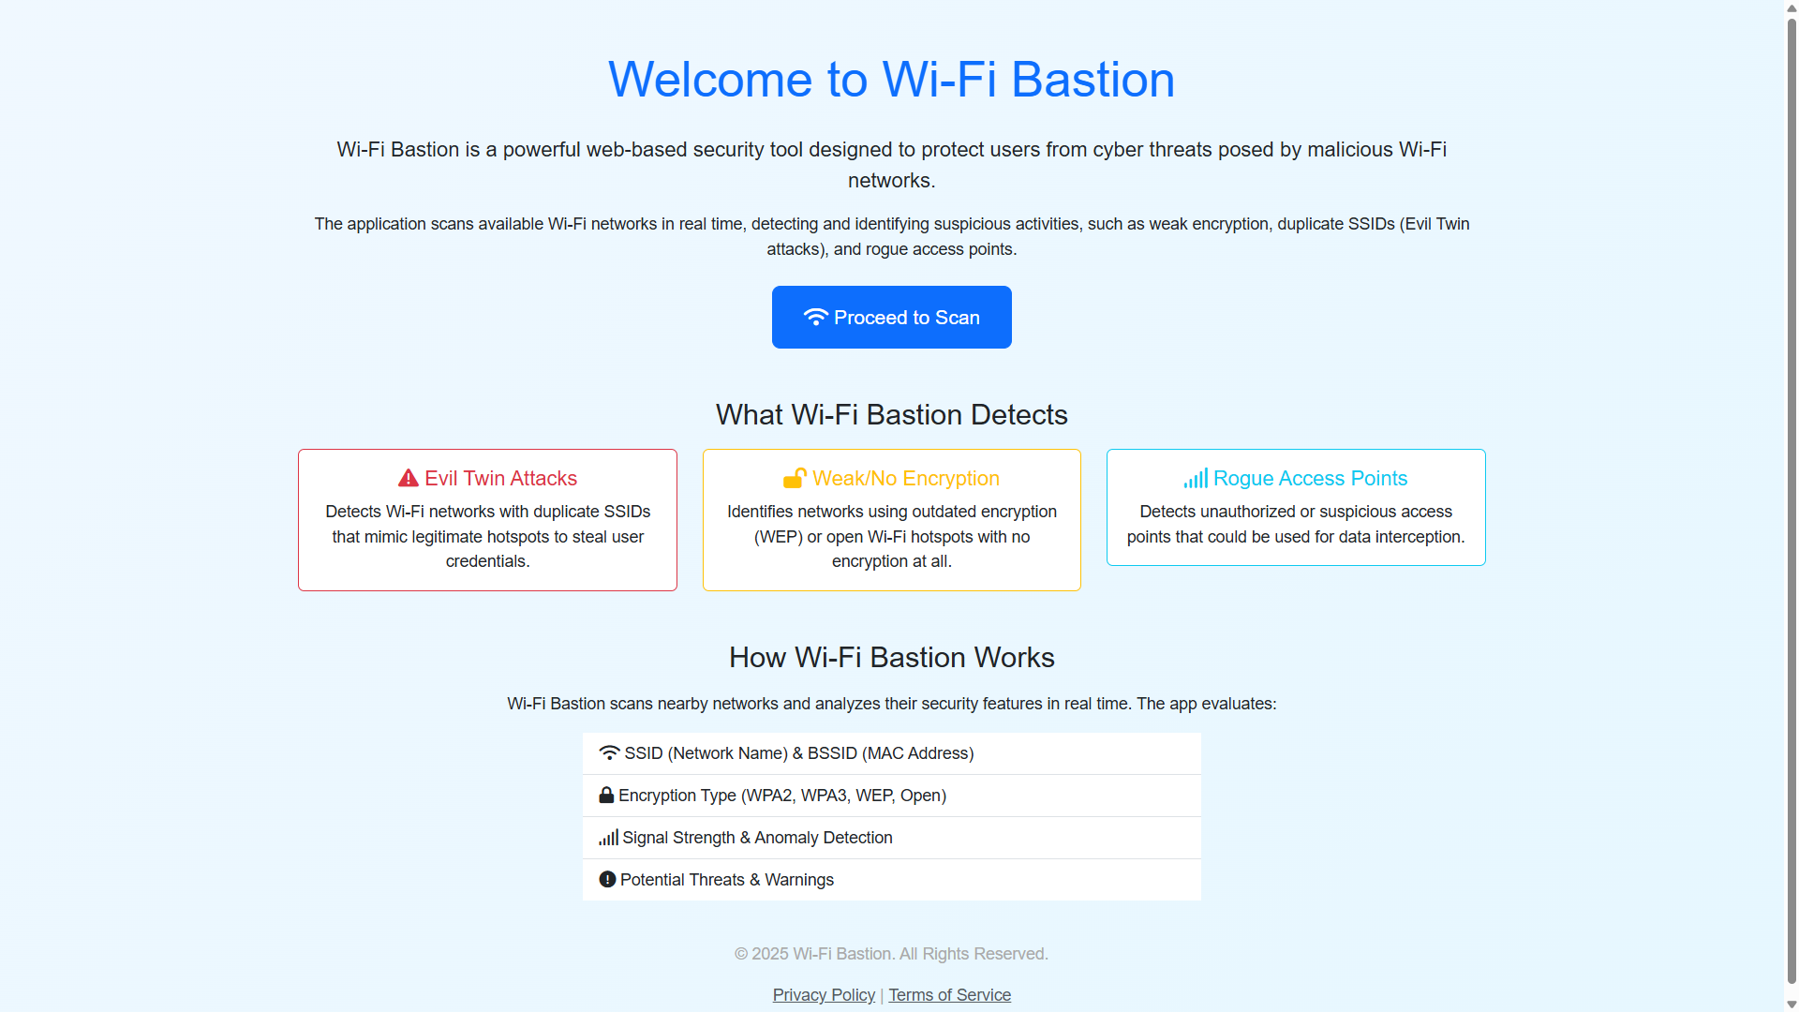
4.4 Test Cases:
4.4.1 Test Case 1 (Home Page):

Slide 42
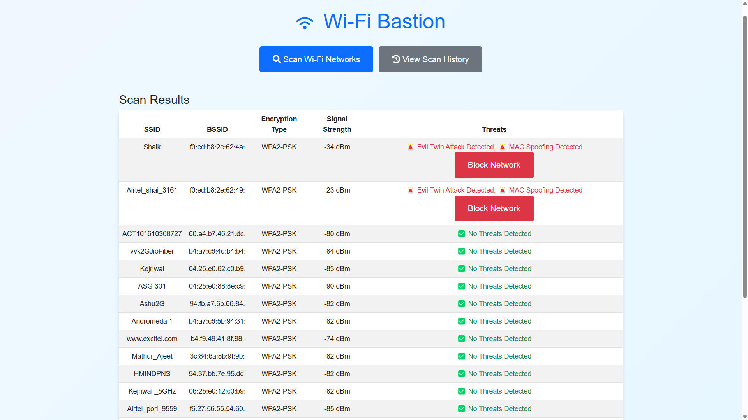
4.4.2 Test Case 2 (Scan Page):

Slide 43
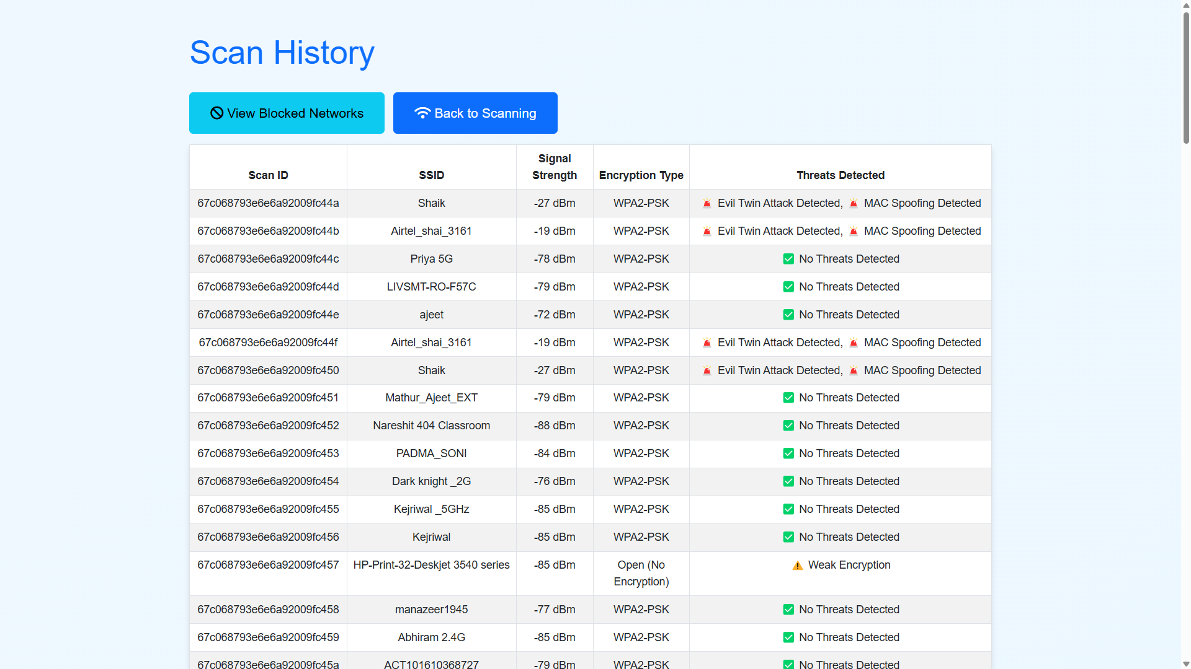
4.4.3 Test Case 3 (Scan History Page):

Slide 44
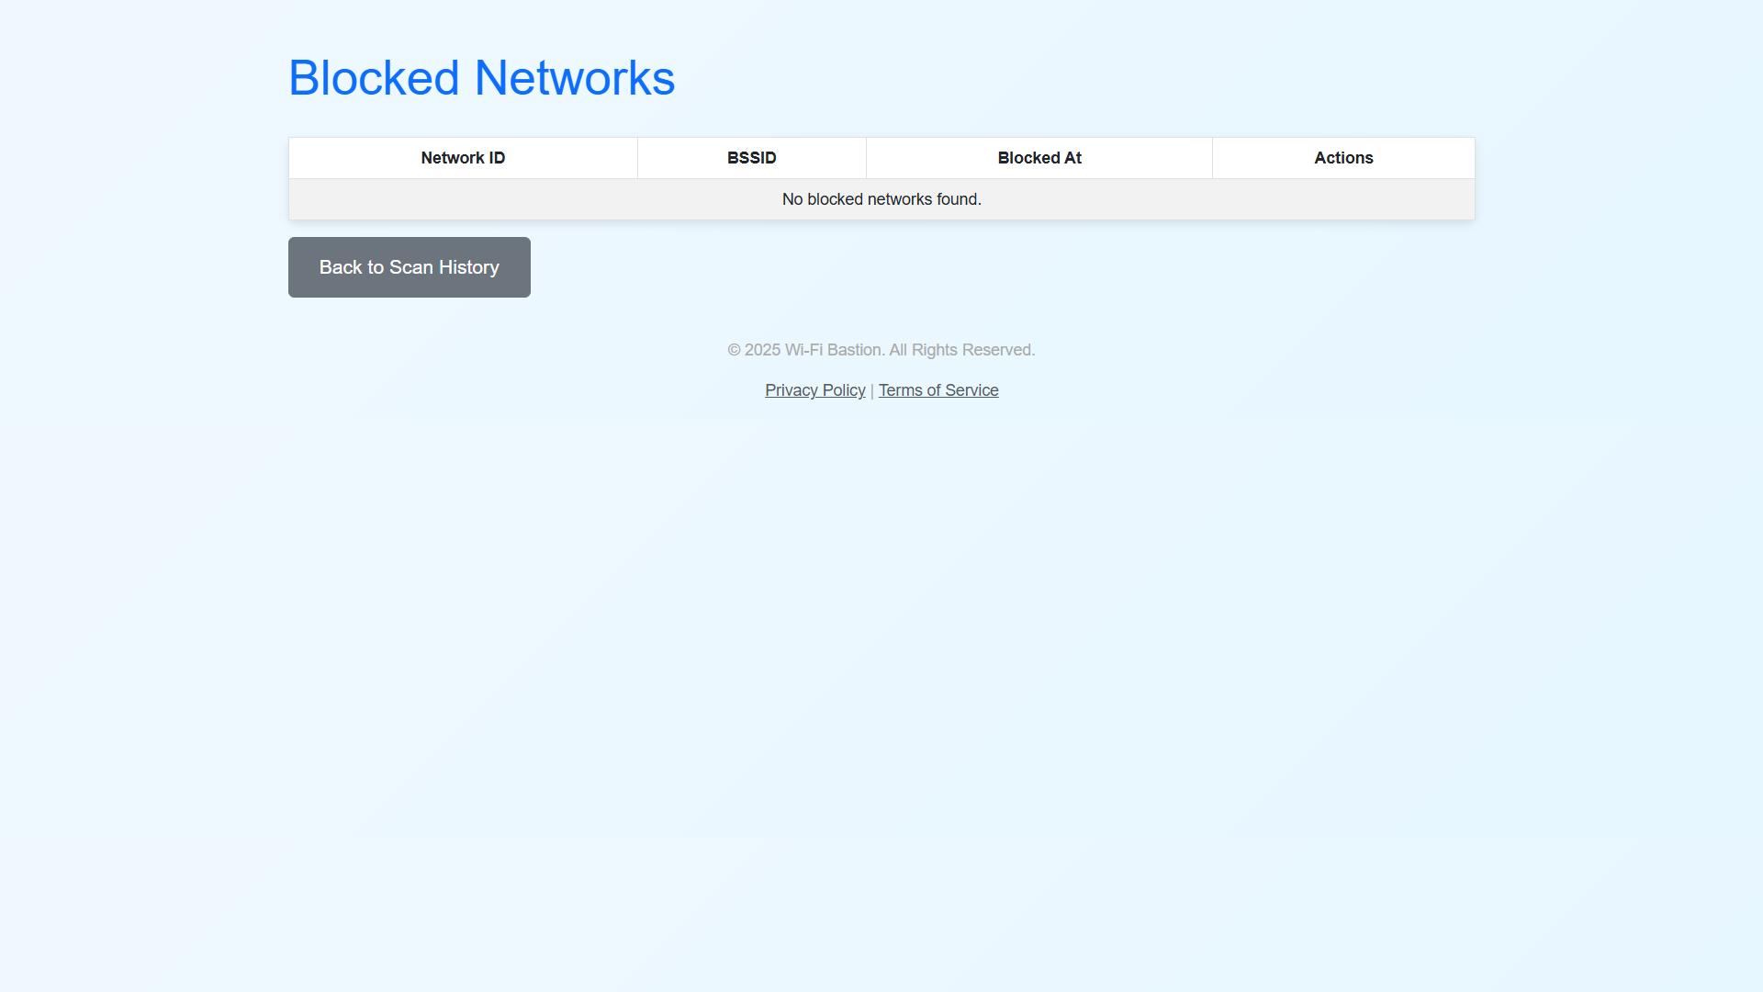
4.4.3 Test Case 4 (Blocked Networks Page):

Slide 45
Thank You

